Slide 1

When you get a friend
Course on Friend Activities of the Finnish Red Cross
Picture: Joonas Brandt / FRC

Slide 2
The principles of the Red Cross
Humanity: Preventing and alleviating human suffering in any way possible is the main mission and goal of the operations of the Red Cross. Its purpose is to protect human life and health and to ensure respect for the human being. It promotes mutual understanding, friendship, cooperation and lasting peace amongst all people.
Impartiality: The Red Cross makes no discrimination as to nationality, religious beliefs, race, political opinions, or class. It endeavours to relieve the suffering of individuals, being guided solely by their needs, and to give priority to the most urgent cases of distress.
Neutrality: In order to continue to enjoy the confidence of all, the Red Cross may not take sides in hostilities or engage at any time in controversies of a political, religious, ethnic or ideological nature.
Independence: The Red Cross Movement is independent. The National Societies, while auxiliaries in the humanitarian services of their governments and subject to the laws of their respective countries, must always maintain their autonomy so that they may be able at all times to act in accordance with the principles of the Red Cross.
Voluntary service: The Red Cross is a voluntary relief movement not prompted in any manner by desire for gain.
Unity: There can be only one Red Cross or one Red Crescent Society in any one country. It must be open to all, and it must carry its humanitarian work throughout its territory.
Universality: The International Red Cross and Red Crescent Movement is worldwide. All its national Societies have equal status and share equal responsibilities and duties in helping each other

Slide 3
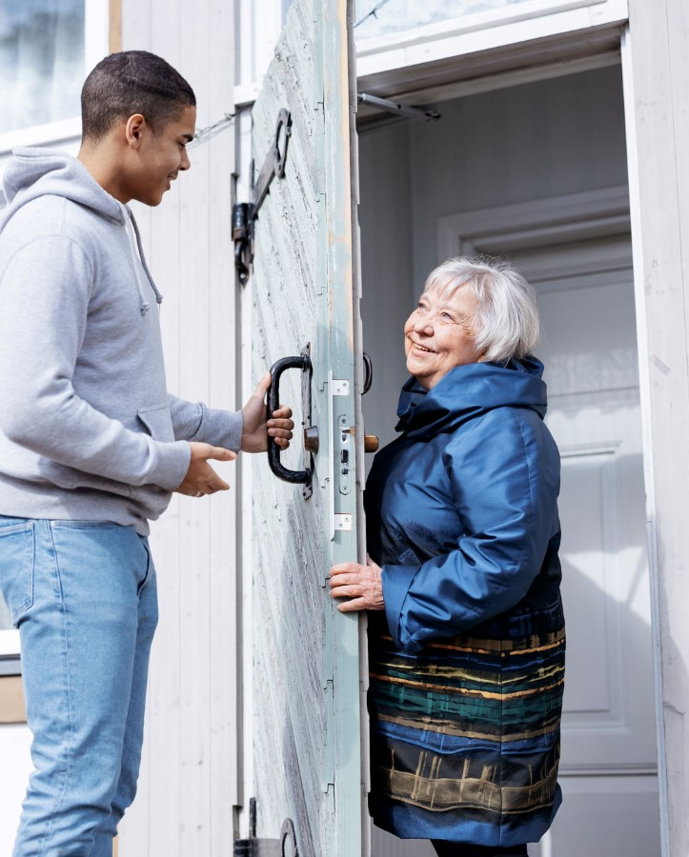
The rules of volunteering in friend activities
No special skills needed
  A volunteer is not a professional helper.
No economical compensation
  No salary or financial compensation is paid for volunteering as a friend, and volunteering must not impose unreasonable costs on the volunteer.
Voluntary participation
  It is important to maintain a sense of voluntarism in all activities.
  The volunteer has the right to choose the times and tasks that suit them and to refuse any tasks that seem unsuitable.
  Volunteers do not have to give their phone number or surname to a friend client in order to protect their privacy.
Kuva: Joonas Brandt / SPR
Picture: Joonas Brandt / FRC

Slide 4
The rules of volunteering in friend activities
Reliability
  Reliability in volunteering comes through sticking to agreed activities, schedules and meeting times. Any changes are communicated in time and in line of good conduct.
  You should also inform the friend service of changes e.g., quitting or other obstacles.
Secrecy and confidentiality
  Volunteers are bound by confidentiality - even on social media and after the friendship has ended.
  However, you can express your concerns to a confidential professional and to the friend service.
Neutrality
  As a volunteer, you do not take sides or get involved in conflicts between others.

Slide 5
The rules of volunteering in friend activities
Acting on the terms of the person in need
  Volunteering is done for the person who needs a friend and listening to their wishes.
  The friend client is encouraged to take an active role.
Equality
  Volunteering is an interaction between people, with respect and equality at its core.
  A volunteer friend is not a better person than their friend, nor a saviour. The parties are equal.
Joy from the activities
  Volunteers have the right to refuse unpleasant tasks. The activity must be enjoyable for both parties.

Slide 6
Volunteers have the responsibility to
follow the Red Cross values and principles as well as FRC guidelines and procedures
commit to activities to which one has volunteered and agreed to
participate in the induction and training required for the tasks
inform about the possible shortcomings, risks or dangers
respect the principle of confidentiality
Volunteers have the right to:
participate according to their motivation and abilities
receive the necessary training, information, guidance and support
participate in the planning and developing the activities, as a member also in the decision making
a safe operational environment
have and give feedback about the activities, as well as feel appreciated
an opportunity to evolve as a volunteer

Slide 7


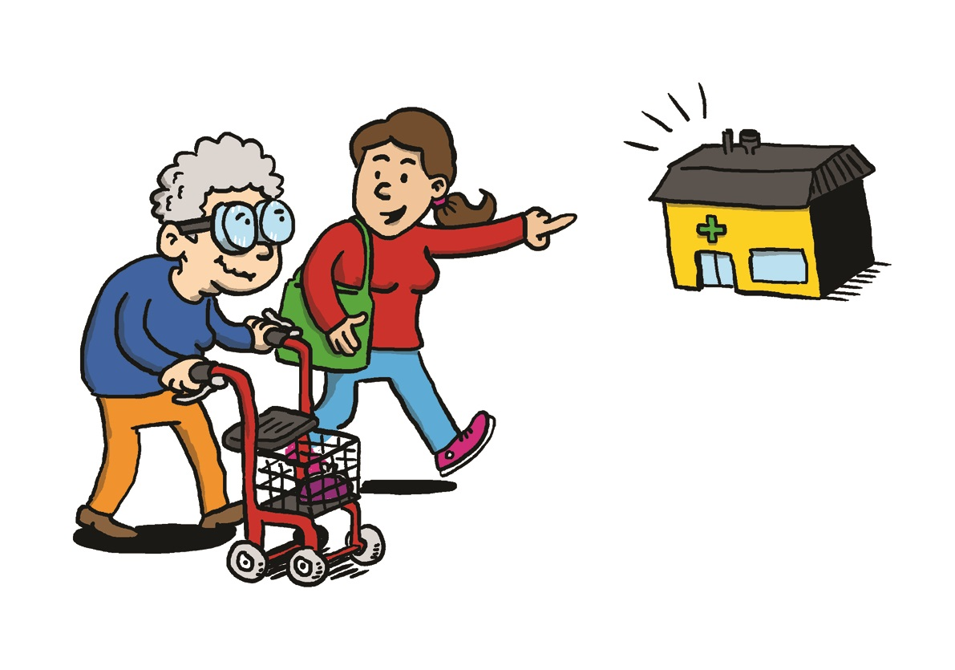
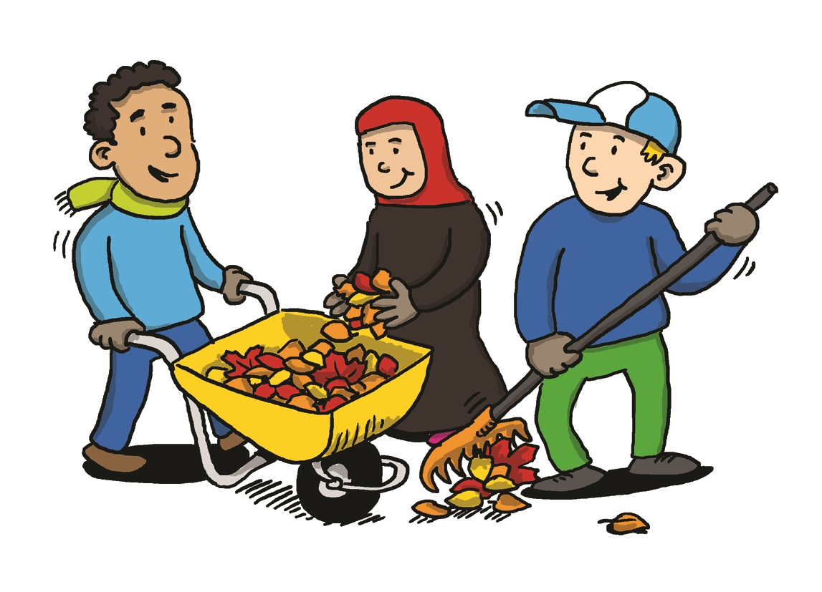
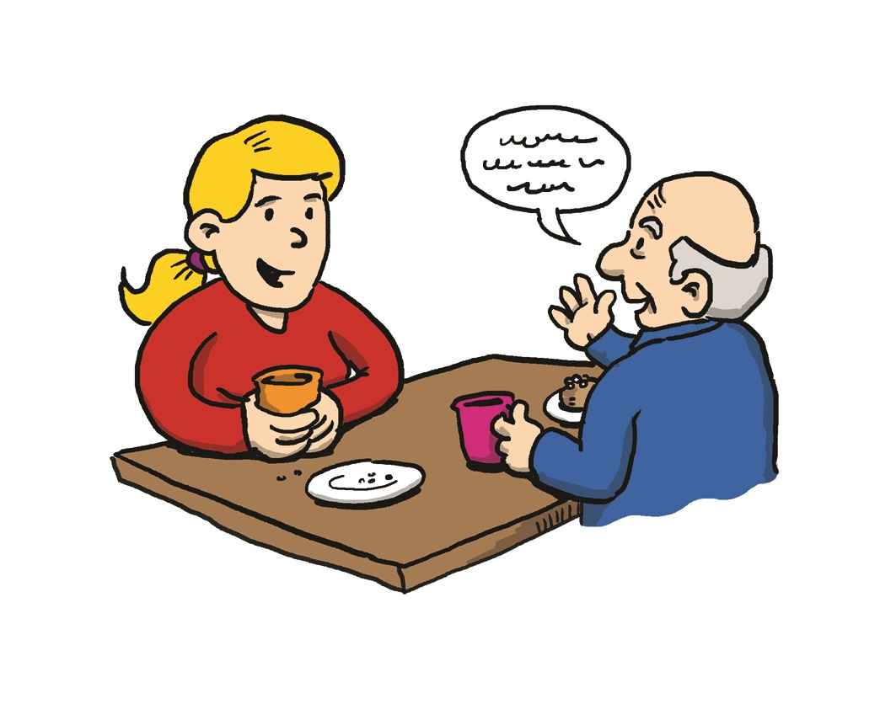
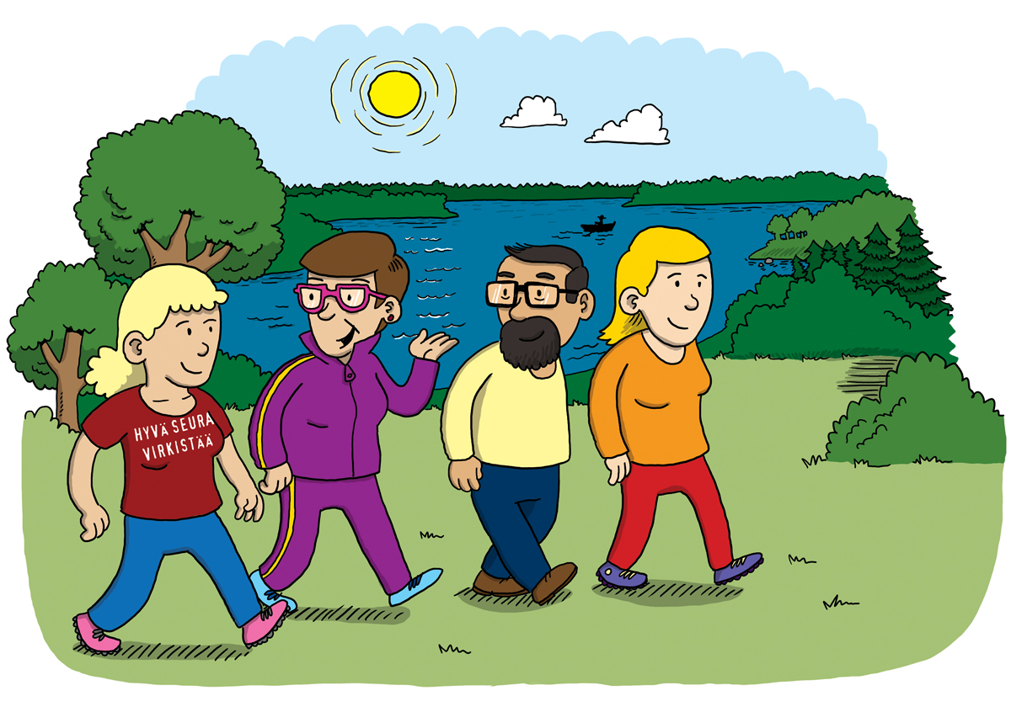
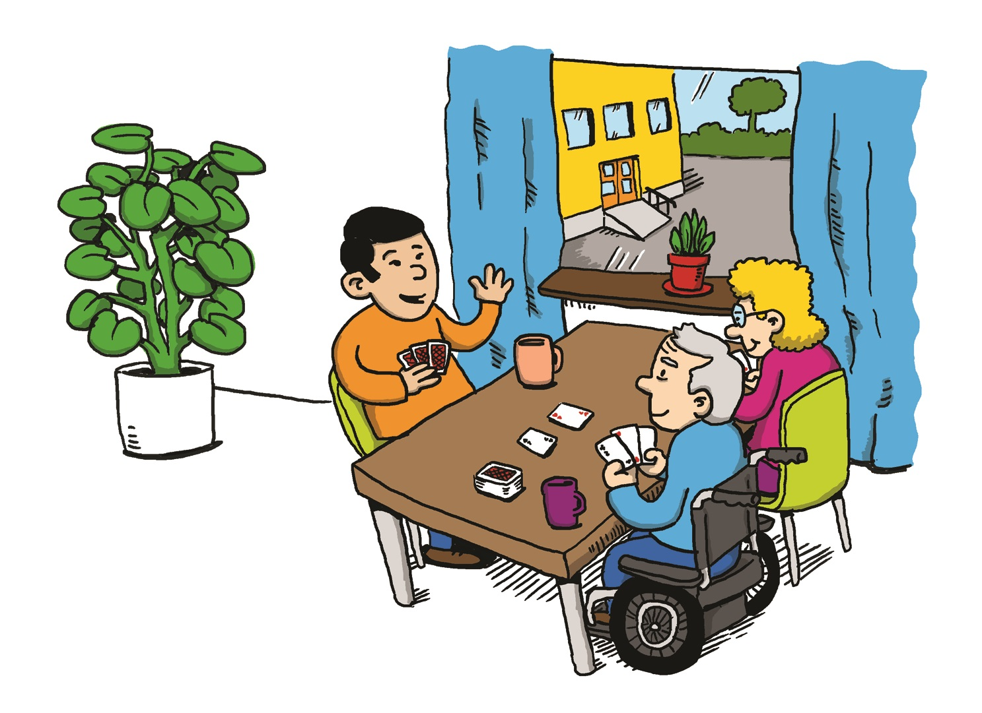
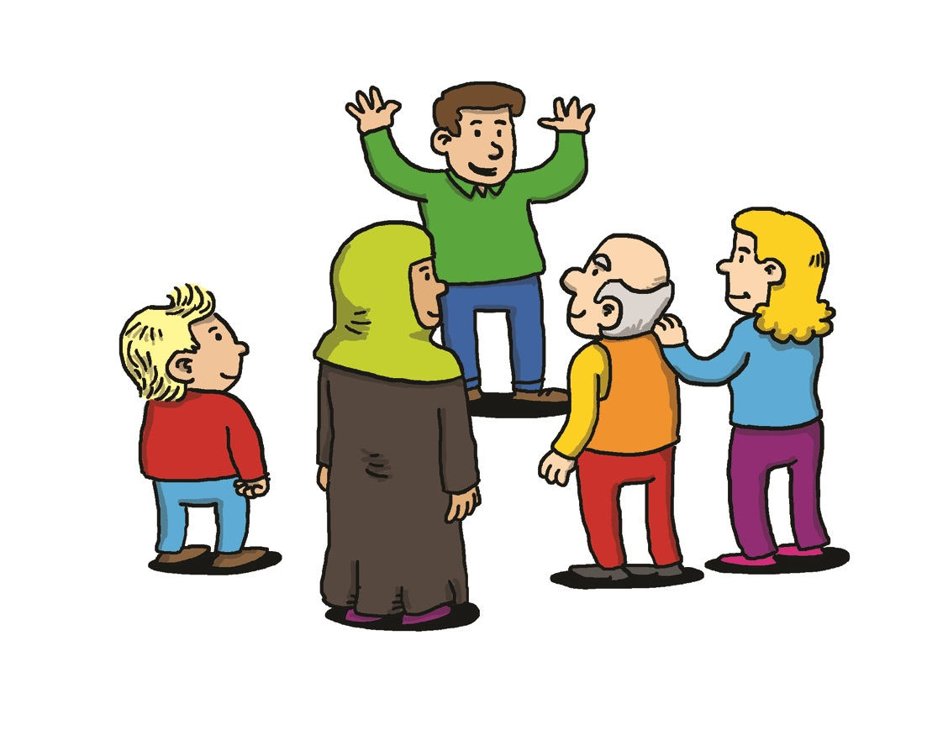
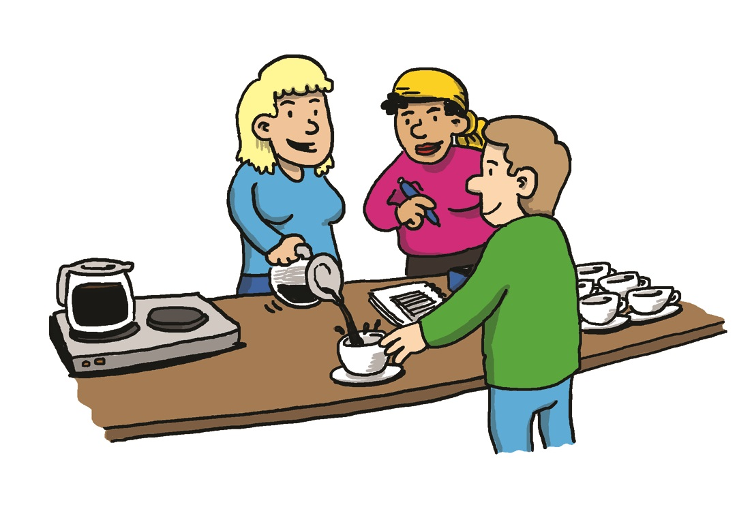
As a friend visitor you can be...
Friend to lonely people
One-to-one meetings: outdoors, activities, chatting, cinema, etc.
Online friends
Family friend to immigrant families or family caregivers
In the friend visitor service
Through the service, you can find a friend visitor or a group of friends
Support and guidance
Short-term help
Short-term help during visits to the doctor, grocery shopping, etc..
As a trainer or a school visitor
You can train new volunteers for friend activities
You can visit schools and introduce friendship skills -program
At open meeting places
Cafes
Communal dining
Cross-generational open meetingplaces: Terhokerhot
Groupleader
Different groups for children, youth, the elderly, immigrants, family caregivers etc.
Spending time together, chatting, excursions, culture-themed-meetings, singing, crafts etc.
Face-to-face or online
Friend in assisted living facilities, hospitals or prisons
Friend visitors visit assisted living facilities and hospitals
Groups and visits to prison
The basis for friend activities
Voluntary service, functional training system, support and guidance, and widespread networks that are local and close to the people
Notes:
What forms of friend activities are locally needed right now?
Please give details of the activities in your area
Specifically highlight activities where new volunteers are needed
Indicate the types of clients currently on the waiting list (immigrants, carers, etc.) and their numbers
Encourage those who want to get involved in group activities,
Presenting the clubs and groups that exist in your subject, area, region

Slide 8
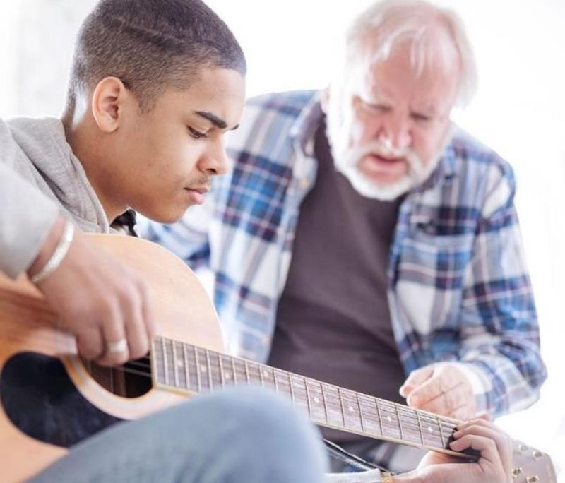
A volunteer friend acts with the skills of an ordinary person
Volunteering is about using ordinary skills, not about being a professional aid. Volunteer friends are not expected to have any professional qualifications or skills.
In the role of a volunteer, the encounter is more genuine, the person is allowed closer.
Sharing difficult things is not mutual
Nor are you a personal assistant, cleaner or other.
If necessary, you may seek help elsewhere together.
Picture: Joonas Brandt / FRC

Slide 9
What do their stories and personal history tell you about their interests?
It has to be fun for both parties
What can you do with a friend?
What has the friend done before, but maybe given up since?
What is the friend interested in?
Things the friend likes
Kuva: Otto-Ville Väätäinen / SPR

Slide 10
”How do you feel?”
Respectful encounters –
knowing how to listen
”What does it mean?”
A good listener…
listens more than talks
shows empathy
doesn’t belittle other persons emotions
supports the other person’s decisions / doesn’t push their own opinions and advice
asks open questions instead of leading ones
asks defining questions
”How did that happen?”
”It’s ok to cry. There’s no hurry.”
”Do you mean that…”
”Please, help me understand what you mean.”
Kuva: Otto-Ville Väätäinen / SPR

Slide 11
Where do you get support?
Friend activities’ group and contact person in the local branch/ voluntary friend service
Red Cross trainings and courses
Peer groups (also social media)
Empowerment events
Professional guidance when necessary (contact the nearest district office)
Volunteer’s insurance
Picture: Joonas Brandt/ FRC

Slide 12
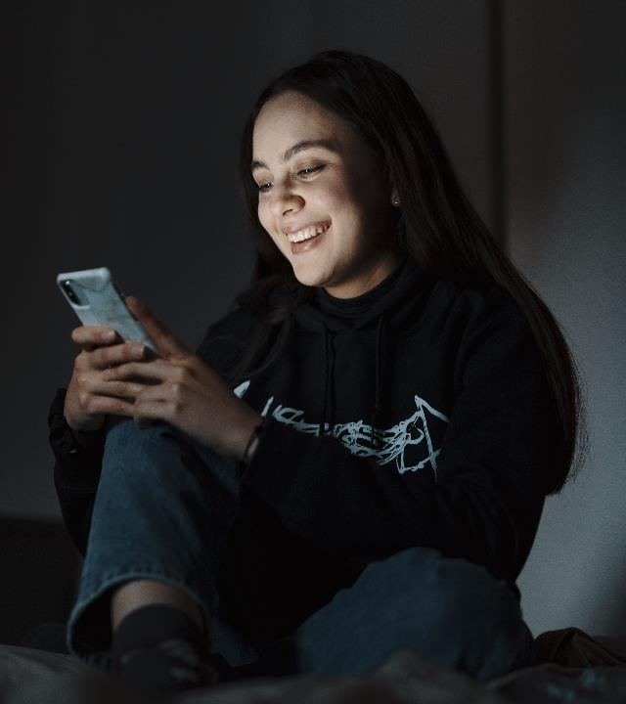
Online friend activities
Online friends have regular anonymous chats with the person that requested a friend, either by email or through a chat app of their choosing.
Online friendship voluntary activity that is not bound by time or place.
You can sign up as an online friend when creating a friend profile. Your details will be forwarded to the national online service, where you will be contacted and provided with a link to a self-study online tutorial for online activities.
Picture: Joonas Brandt / FRC

Slide 13

Young people and mental health
Mental health for volunteers
Making nature part of well-being
Talking about challenging issues
Volunteer friend to a lonely young, adult or elderly etc.
Accompanying to run errands: shopping, doctor’s appointment, etc.
Emotional support
Volunteering with people suffering from dementia
Volunteering in outdoor recreation
Trainer training
Volunteering in hospitals, assisted living facilities and care homes
Volunteering as a prison visitor
Friend activities group leader training
Mentor to other volunteers
One-off friend activities
Supporting a family caregiver
Online friend activities
Training to become a surrogate grandparent
Ready to start right away?
Want more training?
Helping refugees and immigrants
Readiness
Friend service volunteer
Advanced course in friend activities
  Course on Friend Activities 3h

Slide 14
How do I get a friend?
Create a profile in Oma Punainen Risti –system https://oma.punainenristi.fi/ →
The trainer marks you as trained friend volunteer → After getting the mark fill in the volunteer card
Contact from the voluntary friend service → interview
Forming a friend pair / finding a suitable activity
Join the activities

Slide 15
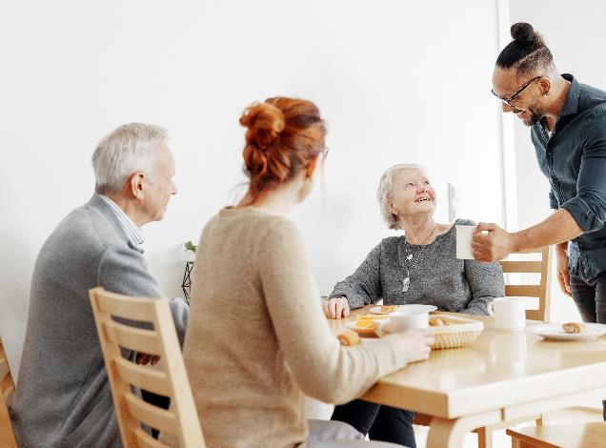


Thank you!
See you at friend activities in your branch, online and social media!
@ystavatoiminta
@punainenristi
@sprystava
@punainenristi
Picture: Jonas Brandt / FRC

