Slide 1
Red Cross Introduction A helper near you
Presenter’s name and date XX.XX.XXXX
Notes:
Photo: Janne Körkkö

Slide 2
1
2
3
Be open
Respect
Create a positive atmosphere
Seven principles of safer spaces
Meet new people and things without prejudice. Approach every encounter as an opportunity to learn something new and develop.
Pay attention to your choice of words and value the opinion of others. Do not mock, embarrass or judge anyone with your words or behaviour.
Also take responsibility for the experience of others. Listen, compliment and encourage.
4
5
6
Avoid assumptions
Give space
Intervene
Do not make assumptions based on external characteristics, skin colour, ethnicity, religion, gender, age or speech. Do not make assumptions about gender, background or functional ability.
Respect the personal space, privacy and personal autonomy of others. Make sure that everyone is heard and give everyone the opportunity to participate.
Do not stand idly by if you witness harassment or other inappropriate treatment.
7
Enjoy
Have fun! Ask questions and search for information if you find anything confusing.

Slide 3
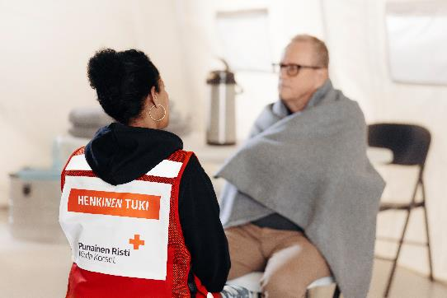
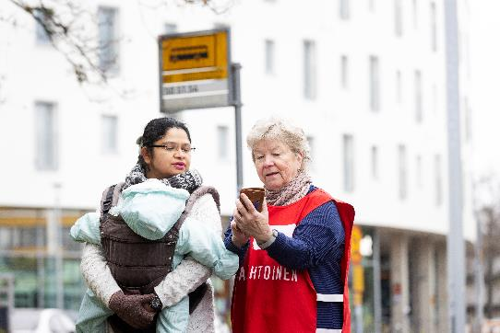

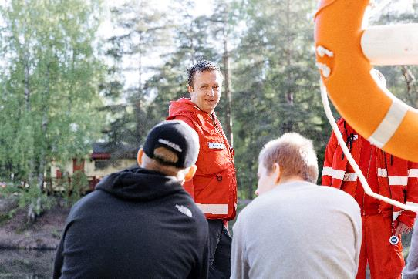
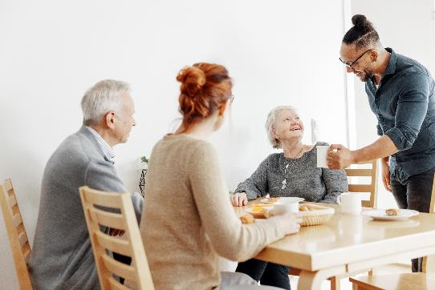
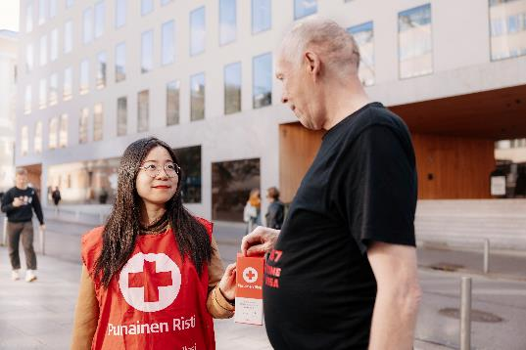
Red Cross – a helper near you
Notes:
This slide can be shown in the beginning of the event when explaining practical matters and having the participants get to know each other. The trainer can alternatively or also show one video from the following slide.
The participants can present themselves and get to know each other.
EXERCISE: The trainer uses the following exercises or similar ones:
Ask the participants to place themselves in a line according to when they registered for the course.
Ask the participants to place themselves on the map according to which town/street/building they live in. The objective is to see which areas the participants come from, and whether they will realise their neighbour is on the course, for example.
Ask the participants to talk to the person sitting next to them: who are you, where are you from, and which volunteer assignments are you interested in.
In connection with the discussion on the exercise, the participants will present themselves to the group and tell the others how they found out about the event. The trainer will ask the participants to explain their expectations and wishes regarding the event. The Red Cross themes the participants are interested in and wish to receive further information on are written on the flip chart in connection with the exercise. As the event proceeds, the trainer aims to ensure these wishes are fulfilled.

Slide 4
Or the trainer uses one of these videos
Together we are the International Federation of Red Cross and Red Crescent societies (3:21 min)
A day in the life of our volunteers (3:26 min)
International Red Cross and Red Crescent Movement: The power of humanity (2:31 min)
Notes:
Please note! Hide or remove this slide if you do not intend to show a video.

Slide 5
The Red Cross Our activities are based on helping. We cooperate to help those in need of help.

Slide 6
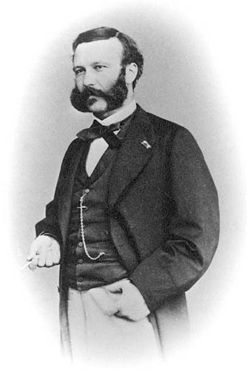
Where did everything start?
Henry Dunant
The battle of Solferino, 1859 (video)
A memory of Solferino, 1862
→ A volunteer organisation to help victims of war; ensuring the care of wounded soldiers through international agreements.
The Geneva committee, 1863, and the Geneva Convention, 1864
Notes:
NOTE! If the participants understand a bit of Finnish or Swedish, the trainer can show the video about the Finnish Red Cross history.
Video of FRC history in Finnish: https://www.youtube.com/watch?v=-XQLmgJqqAA
Video of FRC history in Swedish: https://www.youtube.com/watch?v=4eclTEXdU80
If the participants speak mostly English, then the trainer can show the hole video “Story of an idea” (8 minutes long) instead.
Go through the history of the organisation by showing the first 3:32 minutes of the video ‘Story of an idea’.
After the first video, the trainer discusses the theme with the participants, using the following questions, for example:
What was particularly revolutionary about Henry Dunant’s idea? (Answer: the neutrality of the helping)
Did the video provoke any feelings? What kinds of feelings?
The Red Cross was created 150 years ago at the initiative of Swiss businessman Henry Dunant, who witnessed the cruelty of war up close. Even then, Dunant’s thoughts were used to form the foundation for international humanitarian right: the first so-called Geneva Conventions were signed to protect victims of war and their helpers.
The battle between Austria and France on the fields of Solferino in Italy in 1859: Swiss businessman Henry Dunant arrived on the field and saw 40,000 men dead and wounded on the battlefield. He went to the nearest village, Castiglione, to seek help for the soldiers.
He wrote a book, ‘A Memory of Solferino’ (1862), in which he described the horrors of war through the eyes of an ordinary soldier for the first time.
In his book, Dunant proposed founding an international organisation in peace time, as well as drafting an international agreement to protect the wounded and those caring for them.
A committee was founded in Geneva in 1863 to fulfil Dunant’s ideas, with representatives from 16 countries. The committee proposed that 1) a red cross on a white background be used as the symbol for the medical services, 2) a national relief society be founded in each country, and 3) governments provide their support and protection for these societies. The ICRC was born = The Red Cross was born.
At the initiative of the Committee, the Swiss Government invited a conference of diplomats in 1864, in which representatives of 12 countries approved the first Geneva Convention: they recognised the neutrality and protection of medical services and the improvement of the position of those injured or ill in the army, and confirmed the red cross as the protection symbol of the medical services.
As a piece of trivia, you can tell the participants that Henry Dunant received the first Nobel Peace Prize in 1901.

Slide 7
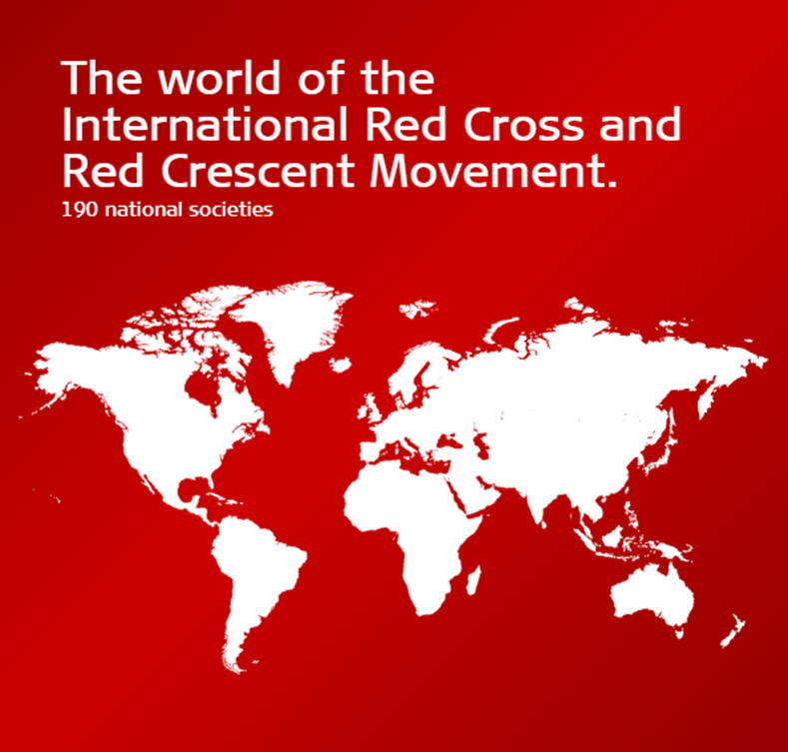

The Finnish Association for the Treatment of the Wounded and Sick Soldiers, 1877 (video)
191 national societies around the world
Protection emblem to protect the relief work
Notes:
NOTE! If the participants understand a bit of Finnish or Swedish, the trainer can show the video about the Finnish Red Cross history.
Video of FRC history in Finnish: https://www.youtube.com/watch?v=-XQLmgJqqAA
Video of FRC history in Swedish: https://www.youtube.com/watch?v=4eclTEXdU80
If the participants speak mostly English, then the trainer can show the hole video “Story of an idea” (8 minutes long) instead.
Show a video about the 140 years of operations of the Finnish Red Cross. A quick discussion with the participants:
Were you surprised about some piece of information about the history of the Finnish Red Cross?
WHAT TO REMEMBER FOR THIS SLIDE (at least these four things should be mentioned).
Tell the participants why the Red Cross enjoys a special position: Finland, for example, has a separate act, the FRC is not a registered association but a society under public law, and it has authority based on the Geneva Conventions.
The 192 national societies form a worldwide network: there are Red Cross or Red Crescent societies helping locally in almost every country.
Explain the basics about the symbols: the difference between the protection symbol and the organisation symbol; the countries own the symbol and monitor its use, but the Red Cross assists in this. The Red Cross, Red Crescent, and Red Crystal are primarily protection symbols.
Explain about the use of the various symbols and why three symbols are needed. The symbols do not refer to religion, but in order to protect relief workers and the protected property, different symbols are needed in different countries. The cross, for example, may be felt as referring to religion, even though it does not in this context.
You can finish by saying that this is an example of how one man’s idea created something big. A person crazy enough to believe to be able to change the world can do so.
The number of national societies may change. Please refer to the IFRC website for the current situation: https://media.ifrc.org/ifrc/who-we-are/national-societies/national-societies-directory/

Slide 8
How the Finnish Red Cross operates
Members
Branches (~450)
- Local activities
- Activity groups
- Branch board
District (12)
- Regional activities, supporting the branches
- District office
- District board
National level
- Headquarters
- Blood Service, Kontti, Emergency youth shelters, Punainen Risti Ensiapu Oy
- Board of Finnish Red Cross
Notes:
Explain the organisation of the Finnish Red Cross briefly. You can add the name of the branch and/or district in question in the picture in order to illustrate the matter. The intention is not to explain everything about the organisation, but rather to inform the participants about which part of the organisation the volunteers operate in, i.e. the branch. Explain that the official meetings of the branch select the board and decide on the guidelines of the operations.
Regarding the district, you can explain that it supports the branches in volunteer operations and organises trainings, for example.
You only need to mention the headquarters.
You can also note a reception centre if one exists within the district.
Members: 74,806 (30 September 2019)
Branches: ~470 (in 2024)
Districts: 12

Slide 9
Principles
Voluntary service
Independence
Universality
Humanity
Impartiality
Unity
Neutrality
Notes:
The intention is not to read all of the explanation texts of the principles. The notes below are mainly intended as support for the trainer.
Discuss the principles. You can use the following exercise, for example.
EXERCISE: The principles
The trainer chooses two principles (e.g. humanity and impartiality) and asks the participants in what ways these principles are visible in their lives. Then, the trainer chooses two new principles (e.g. neutrality, independence, or unity) and asks the participants how these principles should be visible in volunteer operations. If the group is large or it is difficult to get the participants to share their thoughts with the entire group, they can be instructed to talk about the questions in pairs.
The principles can also be discussed by asking the participants what they mean to them and writing words down on a flip chart.
Humanity
The Red Cross was created through the desire to help everyone wounded in war without separating them. It aims to prevent and alleviate human suffering in all circumstances, nationally and internationally. Its purpose is to protect human life and health and ensure respect for the human being. It hopes to promote understanding, friendship, cooperation, and lasting peace amongst all peoples.
Humanity refers to tangible actions: prevention, alleviation, protection, and ensuring respect.
The principle of humanity contains the idea that nothing done to help someone who is suffering is useless or insignificant. Helping whenever necessary is important. This applies not only to the organisation, but also to every individual person. This way, the principle of humanity would be fulfilled in everyday life.
The principle of humanity is the first of seven principles. However, they must be read and understood as one. Many of the following principles are proof of the clarity with which the movement has defined its framework and means for achieving its objectives.
Impartiality
The Red Cross does not separate people based on their nationality, race, religion, social standing, or political opinion in any way. It aims to prevent and alleviate suffering and primarily help those who need it the most.
While the basic principles form a basis for the interpretation of each principle, they also describe the assignment of the movement in different ways.
The principle of impartiality is particularly essential. It inspired Henry Dunant in Solferino, and it has been mentioned in every phase of the definition of the principles. It is also built into the Geneva Conventions.
Impartiality means that help must be given to those who need it, and everyone must be treated fairly. The operations of the movement are based on the policies, principles, and judgement of the Red Cross, rather than the suffering of individuals. This means that all of the aid must be based on factual need, and the order of distribution of the aid must correspond to the urgency of the need of those who need it. Decisions must be made solely based on facts, without prejudice.
Neutrality
In order to maintain the trust of everyone, the Red Cross refrains from comments in case of animosities, and it never interferes with political, racial, religious, or ideological conflicts.
The principle of neutrality is necessary for the operations of the Red Cross and for tangible humanitarian work. Neutrality allows Red Cross representatives to visit political prisoners, for example. It also allows relief transportations marked with the protection symbols to access conflict areas, and may prevent attacks against volunteers of national societies in countries with internal unrest.
Independence
The Red Cross is impartial. The National Societies, while subject to the laws of their respective countries, must always maintain their autonomy and at all times act in accordance with the principles of the Red Cross.
Independence was founded in the early days of the Movement. It contains three factors:
independence as a basic principle,
the role of the national society in assisting authorities in humanitarian matters, and
the need of the national society to remain autonomous in order to be able to act in accordance with the principles of the Red Cross at all times.
Voluntary service
The Red Cross is an organisation providing voluntary and altruistic aid. The fundamental meaning of voluntary service is providing a service for another person without the motivation of a monetary compensation. It is the most direct expression of humanity.
Unity
There can be only one Red Cross or Red Crescent Society in any one country. It must be open to all, and it must carry its humanitarian work throughout its territory.
Universality
The Red Cross and Red Crescent Movement is a universal organisation where all national societies have the same rights and obligations to help each other.
Universality is a precondition for the operations of the International Movement of the Red Cross and Red Crescent Societies. There are a total of 192 national societies, one in almost every country, which is living proof of the universal nature. Some countries do not yet have a national society, and some national societies have not yet been accepted as full members of the Movement because they have not fulfilled the requirements for the recognition of national societies.

Slide 10
Preparedness and preparation
We help efficiently at home and around the world. Helping in sudden emergencies and crises is based on everyday activities, continuous presence, and preparation. We are always prepared.
Notes:
The introduction is intended to form an idea about the Red Cross as a preparedness organisation. We have an assignment and responsibility to assist authorities when they need support. All of our assignments aim to ensure that we are a strong network that is ready to act.

Slide 11
Ready to help
A small fire at home
Spraining an ankle when stumbling
What else could happen to you? It is good to stop for a moment to think about various risks every now and then.
Help from authorities or other actors
Apu viranomaisilta tai muilta toimijoilta
Neighbourly help
Own help
Neighbourly help has been common previously, and it may include help from friends or family. Or why not Red Cross volunteers!
Which authorities help us in our everyday life?
The activities of the Red Cross (and other organisations) support the operations of authorities, and the ability of people to help themselves and others.
Notes:
The aim is to present the aid operations of the Red Cross through our own lives. Discuss the topics on the slide (in pairs if discussion in a large group is difficult):
Step 1) OWN HELP
What does preparation mean?
What are you prepared for at home?
What should you be prepared for in your everyday life?
Step 2) NEIGHBOURLY HELP
When was the last time you helped someone? What was the help like?
What does humanitarian work mean?
Can you come up with examples of humanitarian work by the Red Cross?
These events are only examples, but they could happen to anyone. They are all about personal resilience (preparation), which is the ability to return to normal everyday life. Preparation also refers to
- the ability to prevent accidents (e.g. using electrical equipment correctly to avoid fires),
- the ability to recover from accidents (e.g. first aid in case of a burn),
- and the ability to learn from the situation (e.g. inspecting electrical equipment, reviewing manual extinguishing and first aid skills regularly).
When we can help ourselves, recovering from an event is faster.
We are rarely faced with everyday situations where we need support from authorities or organisations. However, the knowledge that support is available can increase our sense of security. Everyone can improve their ability to help through Red Cross first aid trainings and various kinds of volunteer operations.

Slide 12
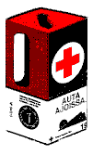
Red Cross Help
B
NATIONAL
SOCIETY
Ì
NS
D
B
Neighbouring
Branches
Nearest
Red Cross
DISTRICT
and other
districts
D
B
Ì
Collectors
Other helpers
Local Red Cross /
Red Crescent
BRANCH
Disaster
Notes:
Aid from the Red Cross helps using the same logic as personal preparedness: first comes local help, then regional and national help, and if necessary, international help.
When our own help is not enough, it is important to know that the network can help. Neighbourly help can expand to the neighbouring branch or another organisation in the region, when internal resources are insufficient. The Red Cross network is based on the obligation to assist when requested and to ask for help when internal resources are insufficient.
In this context, a disaster could be major flooding in Mozambique, a school shooting in Kauhajoki, or any other event for which the internal knowledge, hands, or other resources are not enough. Help can be asked for from as far as necessary, sometimes internationally from other national societies. Asking and providing help can be divided if necessary, ensuring that the requester and provider are close to the people and that the help passes from person to person, even if through several intermediaries.

Slide 13
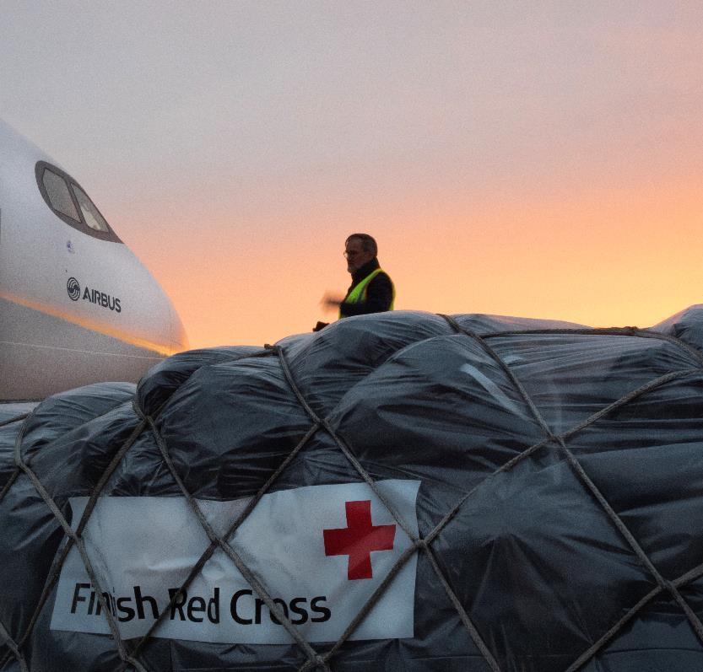
Help in practice
Collections
Hunger Day
Emergency aid collections
Disaster Relief Fund
Enables quick and efficient aid
International aid
Aid equipment, development cooperation, aid workers
Cooperation with the local Red Cross or Red Crescent society
Picture: Mari Vehkalahti
Notes:
Collections (Hunger day and emergency aid collections)
- Emergency collections are initiated in response to major disasters in Finland and around the world. In addition to emergency collections, funds are collected during campaigns, the most important of which is the annual Hunger Day collection organised in the autumn.
Disaster Relief Fund
Thanks to donations, the disaster relief fund is able to provide quick and efficient aid.
Approximately 90% of the donations to the disaster relief fund come from private donors.
The collection expenses of the disaster relief fund are not allowed to exceed 20%.
International aid
- We provide aid materials for disaster areas and support development cooperation programmes. - The aid is delivered in cooperation with the local Red Cross or Red Crescent society.

Slide 14
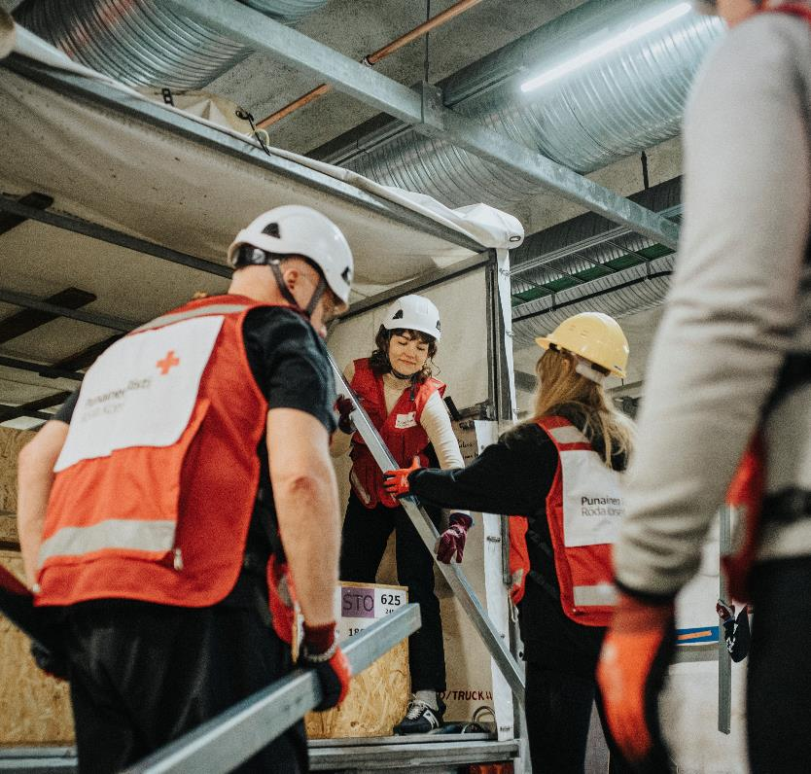
Aid in Finland
Volunteers help victims of accidents and support the authorities.
Aid is given in sudden accidents with unreasonable consequences for an individual or family, and which make coping with everyday life difficult.
It can be provided as psychosocial or material support.
Picture: Benjamin Suomela
Notes:
Aid in Finland
- In Finland, aid is most often provided as psychosocial support or material aid, for example to victims of a fire. - The operations of the Voluntary Rescue Service are supported through the disaster relief fund.
The operations of the Voluntary Rescue Service (Vapepa) are also supported through the disaster relief fund.
The Voluntary Rescue Service is a network of 53 organisations whose emergency teams support the authorities when accidents or other crises occur. In most cases, Vapepa is called in to search for a missing person, but volunteers are also needed to provide emotional support, control traffic, or assist with evacuations. Our helpers operate on the ground, in water areas, or up in the air. The Vapepa organisations work together so that the competencies of each organisation can be utilised in an emergency to aid the person in need. During an emergency, Vapepa leads its respective operations. The Finnish Red Cross coordinates the operations of Vapepa.

Slide 15
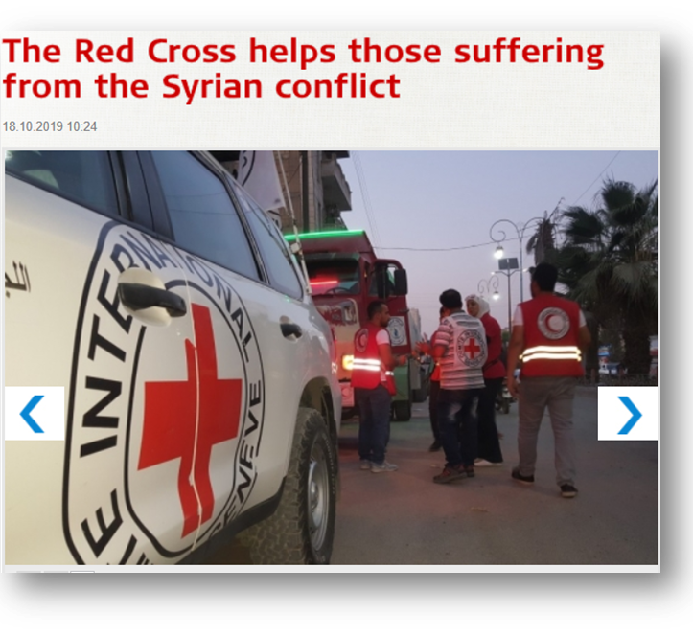
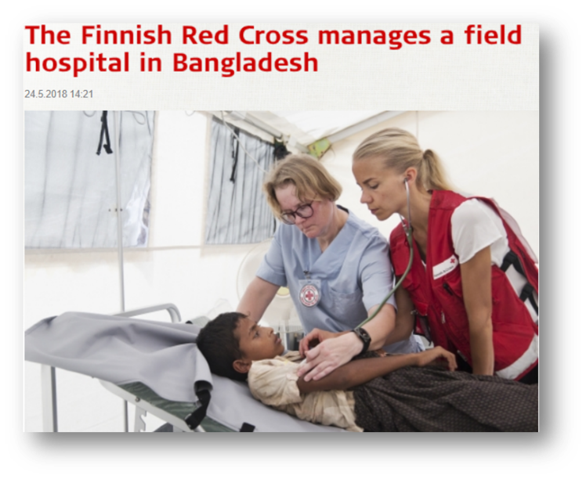
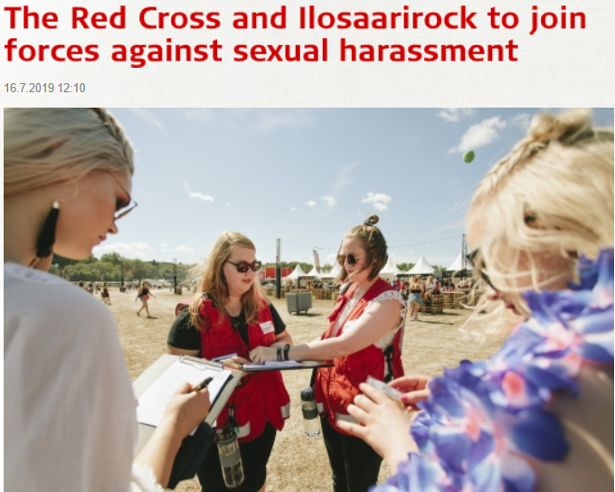
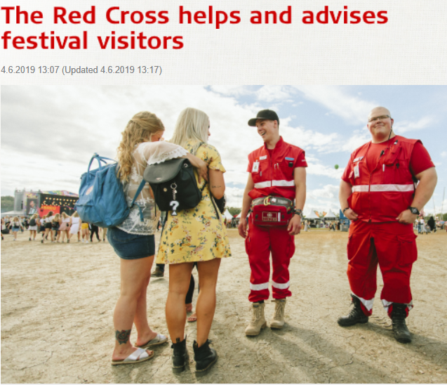
Notes:
Examples of humanitarian work by the Red Cross.
You can add some examples from local operations and delete some of the more general ones.

Slide 16
Versatile volunteer activities

Slide 17
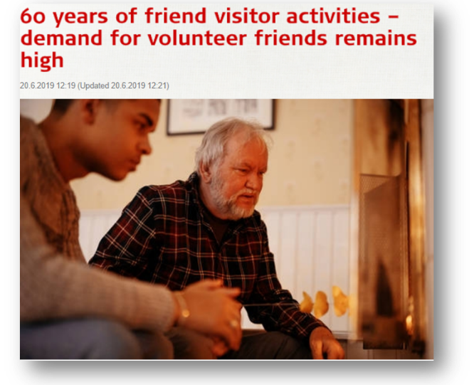
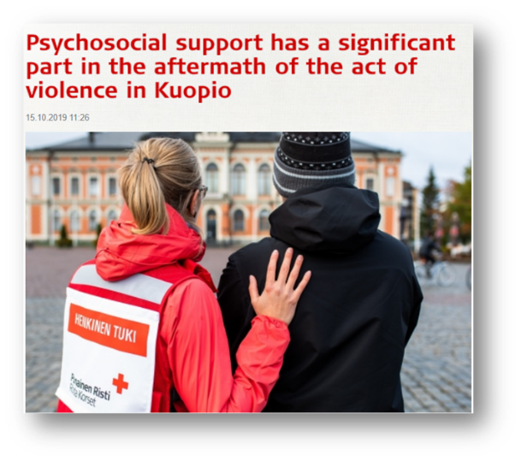
Who is a volunteer?
Volunteers are the most significant resource of the Red Cross.
Participate in the volunteer activities of their own will.
Does not pursue material or financial gain.
Volunteers act without pay ‘from person to person.’
Notes:
The trainer and representative(s) of the branch start by telling their stories of why they joined the FRC as volunteers and what volunteering mean to them.

Slide 18
Volunteers are insured against accidents that occur during voluntary activities.
In voluntary activities, you commit to
confidentiality
ethical principles
guaranteeing a safe environment for yourself, other volunteers and recipients of aid through your own actions.
It is important for the Red Cross to ensure a safe environament and activity for its volunteers, recipients of aid and employees.
The organization operates on the basis of equality, in accordance with the Data Protection Act and has zero tolerance for racism, bullying, corruption and sexual harassment.
Notes:
Insurance: https://rednet.punainenristi.fi/system/files/page/Vapaaehtoistoiminnan%20vakuutus%202019_en_0.pdf
Eettiset ohjeet: https://rednet.punainenristi.fi/node/26573
Seksuaalisen häirinnän ja ahdistelun vastainen linjaus: https://rednet.punainenristi.fi/system/files/page/SPR%20linjaus%20seksuaalisen%20h%C3%A4irinn%C3%A4n%20ja%20hyv%C3%A4ksik%C3%A4yt%C3%B6n%20ehk%C3%A4isy.pdf
Tietosuoja: https://www.punainenristi.fi/tietosuoja
On tärkeää sanoa, että emme hyväksy minkäänlaista seksuaalista häirintää, ahdistelua, hyväksikäyttöä, rasismia tai kiusaamista.
Pyrimme kaikin keinoin siihen, että SPR on kaikille turvallinen toimintaympäristö.
Järjestö varmistaa, että tietosuojalakia ja ihmisten tietosuojaa kunnioitetaan.

Slide 19
A low threshold to report possible misconducts or sexual harassment. www.redcross.fi/whistleblow
Notes:
Tell the participants, that the organisation aim to assure that every volunteer knows which are the channels to use if they want to inform possible misconducts or sexual harassment.

Slide 20
What do you think?
As a volunteer, you will receive the training, information, and guidance you need for your assignment.
Even though you promised to carry out a volunteer assignment, you can skip it if the weather is bad, because you are a volunteer.
When you become a volunteer, you are obliged to participate in the activities appointed to you by the Red Cross.
You may need to commit to confidentiality in your volunteer assignment.
As a volunteer, you will work with those in need of help or support in a manner that helps strengthen their own resources.
As a volunteer, you commit to following the principles of our society and reporting any deficiencies you notice.
As a volunteer, you can make a difference.
Notes:
Thumb barometer on the statements. The participants show thumbs up or thumbs down whether they agree or disagree, or maybe something in between.
Answers and justifications:
As a volunteer, you will receive the training, information, and guidance you need for your assignment.
Correct x
Incorrect
Grounds: The Finnish Red Cross is a large training society, and we provide plenty of training regarding the Red Cross and its various forms of activities. Supplementary training events are also organised.
Even though you promised to carry out a volunteer assignment, you can skip it if the weather is bad, because you are a volunteer.
Correct
Incorrect x
Grounds: As a volunteer, you must commit to the activities in the way you have voluntarily agreed upon. The reliability of the aid is based on the volunteers doing what they have promised to do.
When you become a volunteer, you are obliged to participate in the activities appointed to you by the Red Cross.
Correct
Incorrect x
Grounds: You are, of course, allowed to decide for yourself what kind of activities you wish to participate in and to what extent. The individual assignments are always agreed on together. You can often also use your professional expertise.
You may need to commit to confidentiality in your volunteer assignment.
Correct x
Incorrect
Grounds: It depends on the nature of the assignment. Not all assignments are confidential, but the names or other personal information of those helped must not be spread.
As a volunteer, you will work with those in need of help or support in a manner that helps strengthen their own resources.
Correct x
Incorrect
Grounds: The competence and resources of the recipients of help are considered and strengthened by training, supporting, and acquiring the aid materials as close to the recipient as possible, for example.
As a volunteer, you commit to following the principles of our society and reporting any deficiencies you notice.
Correct x
Incorrect
Grounds: These are preconditions for being able to act as a volunteer at the Red Cross.
As a volunteer, you can make a difference.
Correct x
Incorrect
Volunteers make a difference by helping with what they consider important. You make a difference simply by doing something. The volunteer organisations also provide a channel for participating in social discussion, for example. Taking on a position of trust increases your possibilities and channels for making a difference in something important. This makes volunteer activities socially significant. It also supports democracy and civil society, while increasing well-being and communality.

Slide 21
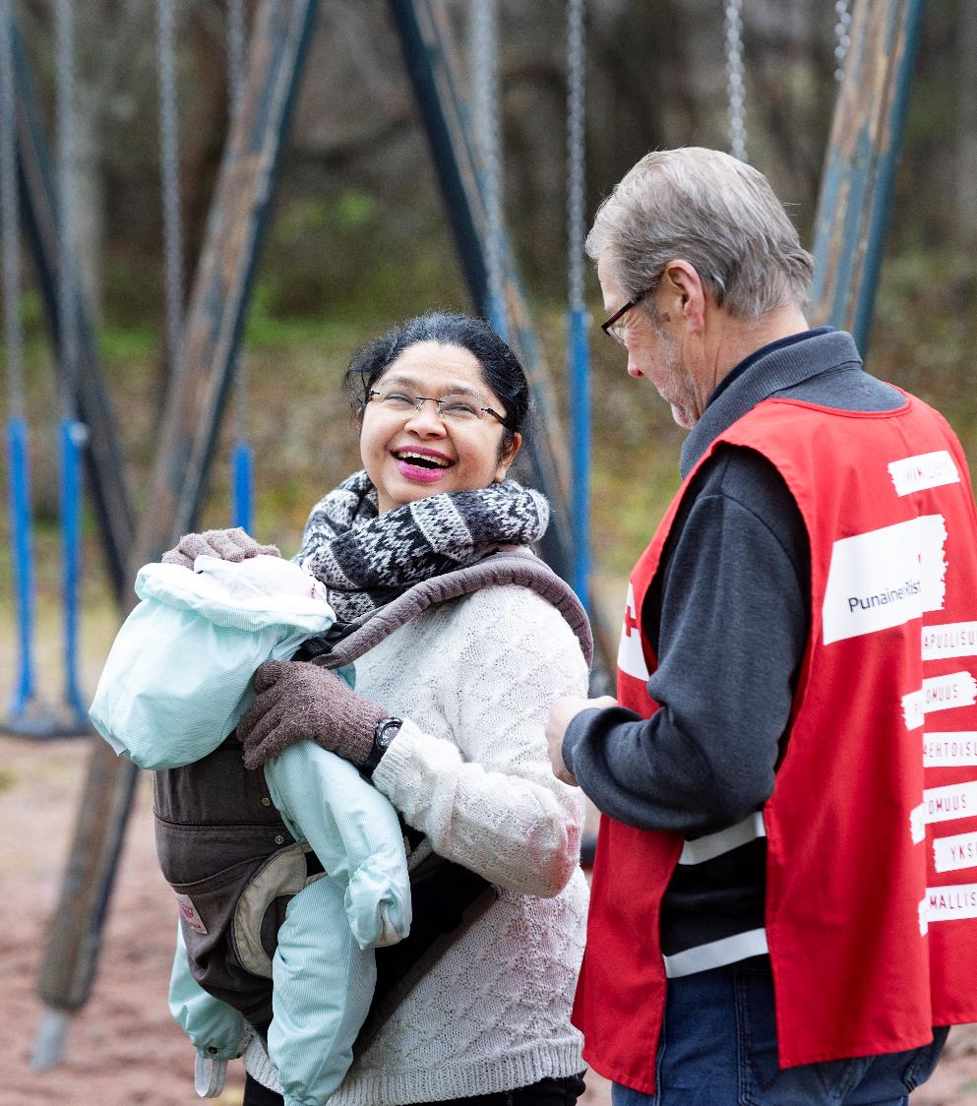
As a volunteer, you can help and support someone
Emergency Youth Shelters
Prison visitors
Support activities for immigrants
Friend visitor activities
Plus Point
Health Point
Food aid
Substance abuse work
Sexual health work
First aid duty operations
Homework help
Psychosocial support
Crisis and support chat
Picture: Suvi Elo
Notes:
The next six slides list forms of volunteer activities. The lists are not meant to be complete, and several activities are mentioned more than once.
You can freely edit the lists to suit yourself and your region.

Slide 22
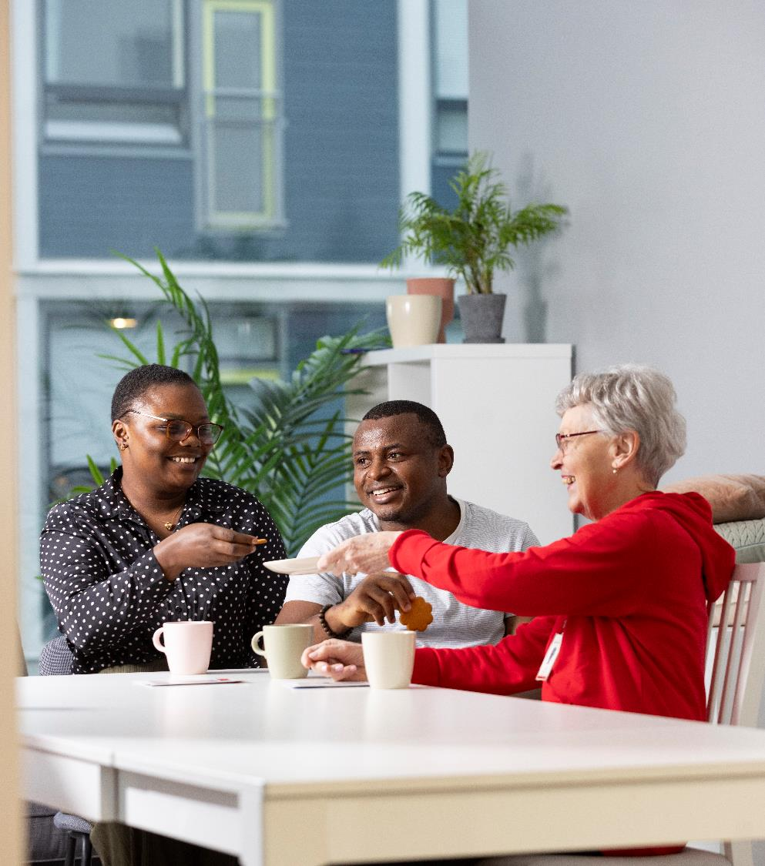
In a group
Friend visitor clubs
First aid groups
Language-learning clubs
Reddie Kids clubs
Youth groups
Psychosocial support
Substance abuse groups
Primary care groups
Picture: Suvi Elo

Slide 23
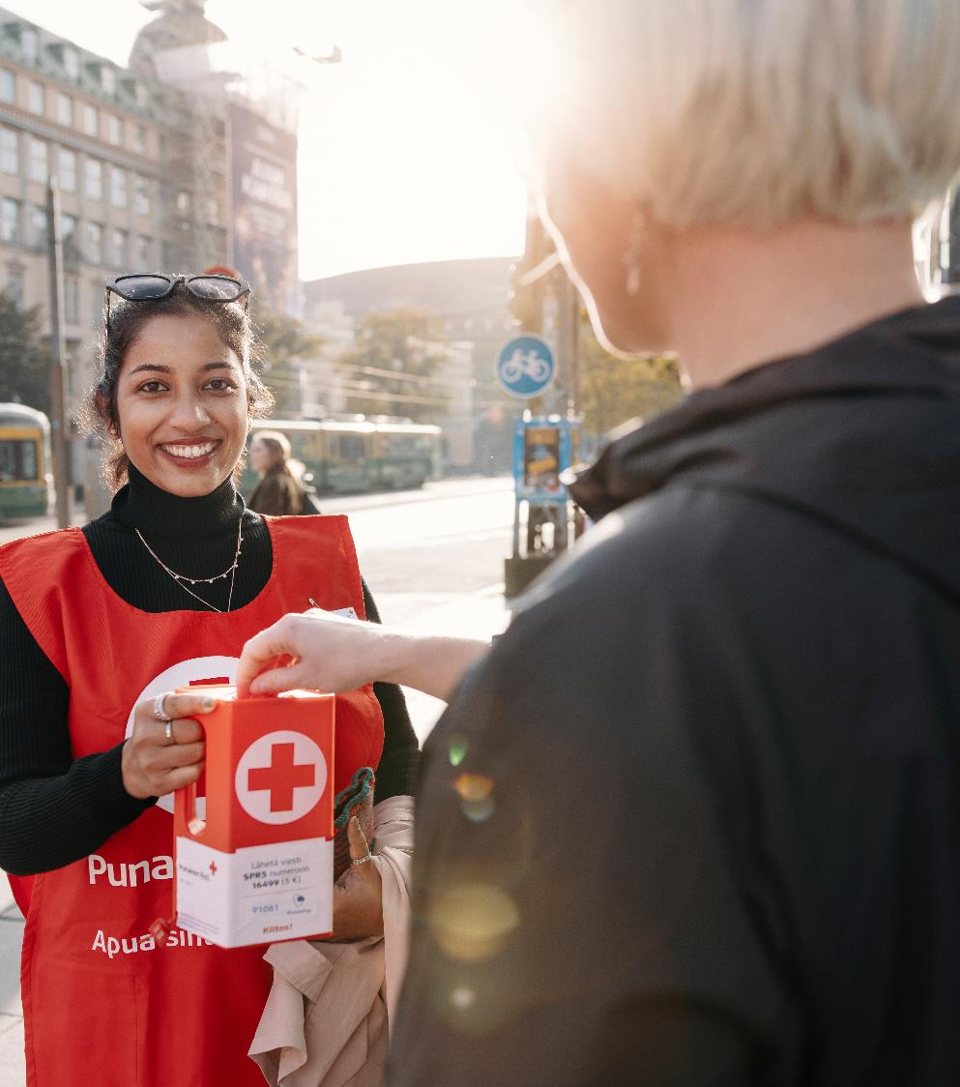
One-off
Collections
Trade fairs and events
Campaigns
Blood-donation happenings
Other events
Picture: Joonas Brandt

Slide 24

Online
Communications volunteering
Crisis chat
The Sekasin chat
Digital sponsoring
Online friend activities
Picture: Jukka Erätuli

Slide 25
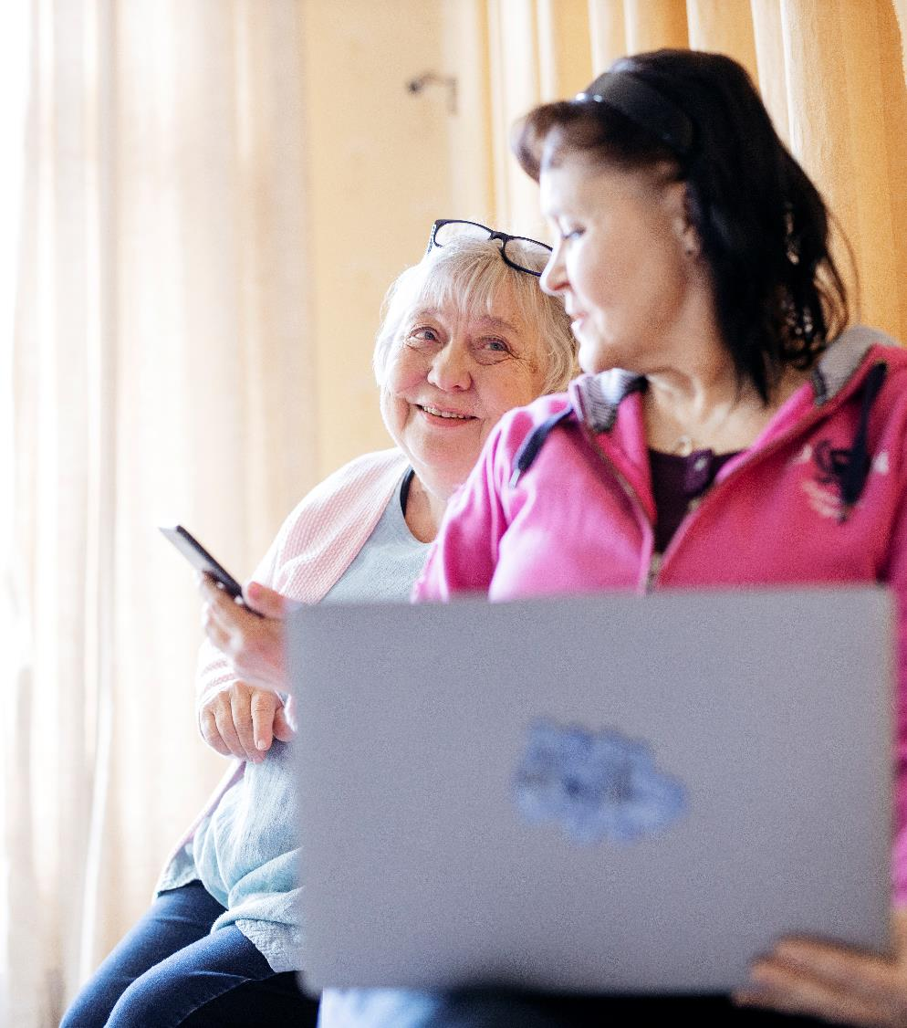
As an influencer
Positions of trust
Social media ambassador
School cooperation and school visitor operations
Annual branch meetings
Participating in the activities
Picture: Joonas Brandt

Slide 26
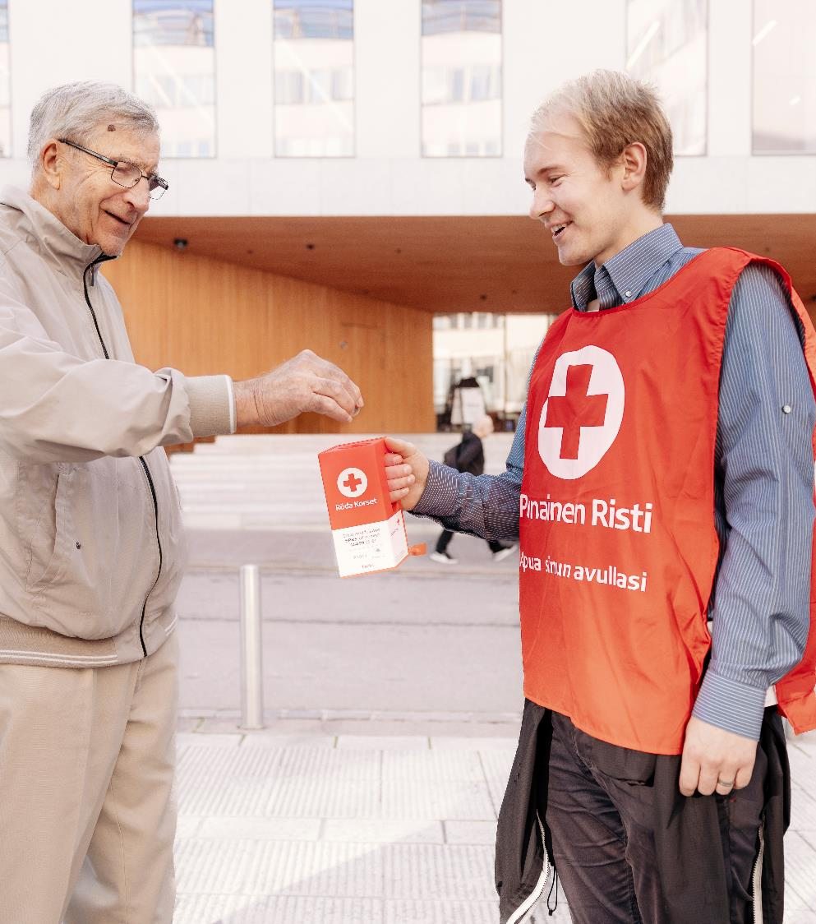
By donating
Blood donation
Shopping at or donating to the Kontti stores
Donating to a collection
Monthly donation
Wills
Donations for special days
Donating time for volunteer work
Picture: Joonas Brandt

Slide 27

As a member, you are a helper
A simple way of supporting the aid work by volunteers and taking a stand for humane values and objectives.
The membership fee is 20 euros, or 10 euros for people under 29 years old.
www.redcross.fi/get-involved
Join on your smartphone, you can do it right now!
Picture: Joonas Brandt

Slide 28
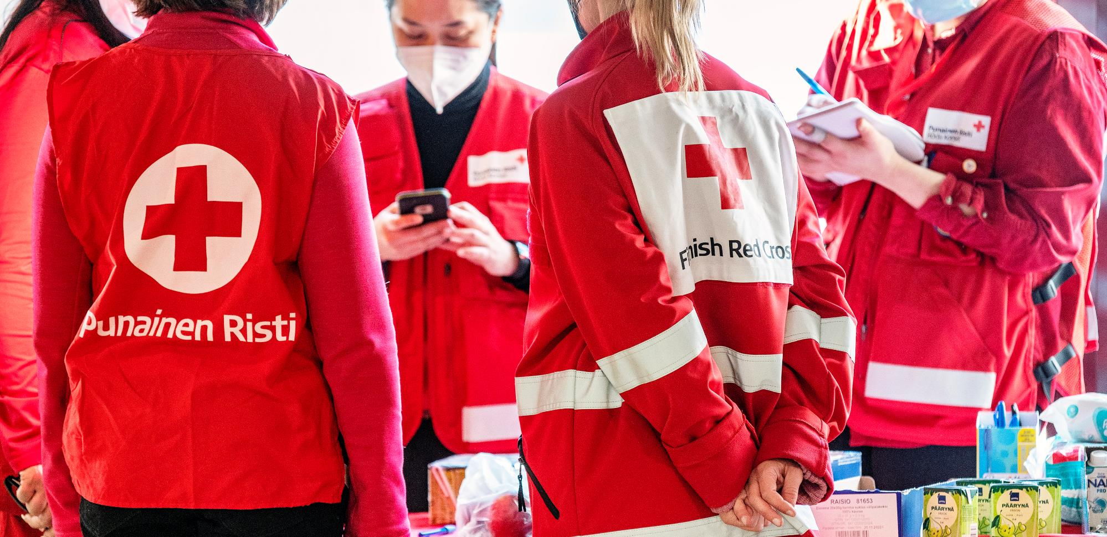
Picture: Ville Palonen
Welcome to join the activities
Notes:
At this point, check whether the participants have further questions, and tell them that they can ask questions from the branch representatives even after the event.

Slide 29
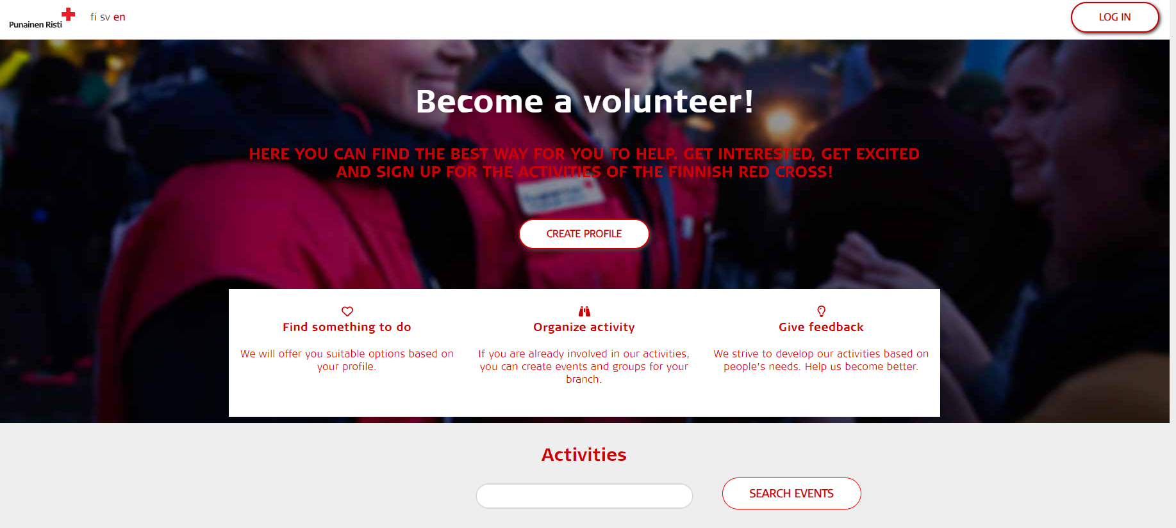
OMA Punainen Risti – activities and events
Notes:
NOTE! If the participants can speak a bit of Finnish or Swedish, the trainer can show OMA Punainen Risti webpage and tell about it. But if the participants speak mostly English the trainer can ignore this part of the training and only tell about the main webpage and social media channels. OMA Punainen Risti will be translated in English when the next big development steps of the system have been taken during 2020.
If you have time and the participants are interested, you can show the OMA front page and allow the participants to register in OMA on their phones during the training. If this is not possible, you can show from your screen what OMA Punainen Risti looks like, how it can be accessed, and what it contains.
During the OMA presentation, show the information of the branch in question and the OMA branch view. If the branch is not registered in OMA, show the contact information for the branch from Rednet.
Encourage the participants to register to OMA and remind them that registration will not cause their email to flood with ads or other messages. Tell them that OMA Punainen Risti compiles the entire activities and events of the Finnish Red Cross in one place. The participants can later enrol for courses, trainings, and other operations through OMA. If they create a profile, they can find out about actiovities near them, but registration does not bind them to anything.

Slide 30
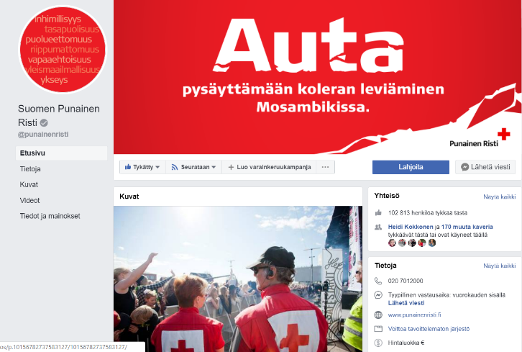
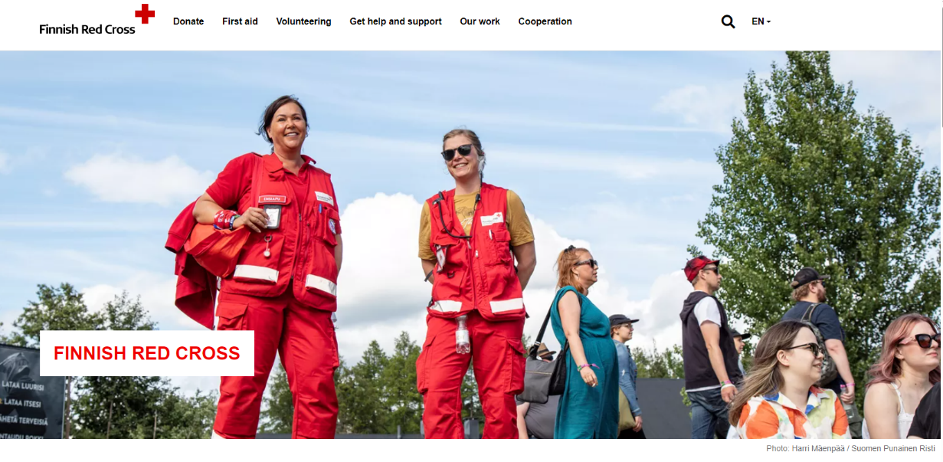
On internet – national and local
Notes:
You can get more information about the Red Cross through:
the website redcross.fi
social media (Facebook, Instagram, Twitter)
the national channels and websites, and
the regional and function-specific sites and profiles (Add screenshots of branch, district, and operating group social media channels as examples).
Encourage the participants to publish stories and pictures of their volunteer activities or donations on social media.
Remind them to ask permission from those in the picture before publishing, and being particularly careful and requesting parental permission with pictures of underaged children.
In helping situations, remember to respect the privacy of the recipient of the help.

Slide 31
Current information (regional information)
The trainer and/or branch lists upcoming events and topical issues in the region, which the new volunteers can join.
List or share contact information of the branch to the participants.
Notes:
PLEASE NOTE! The trainer and branch representatives will compile this list in advance.

Slide 32
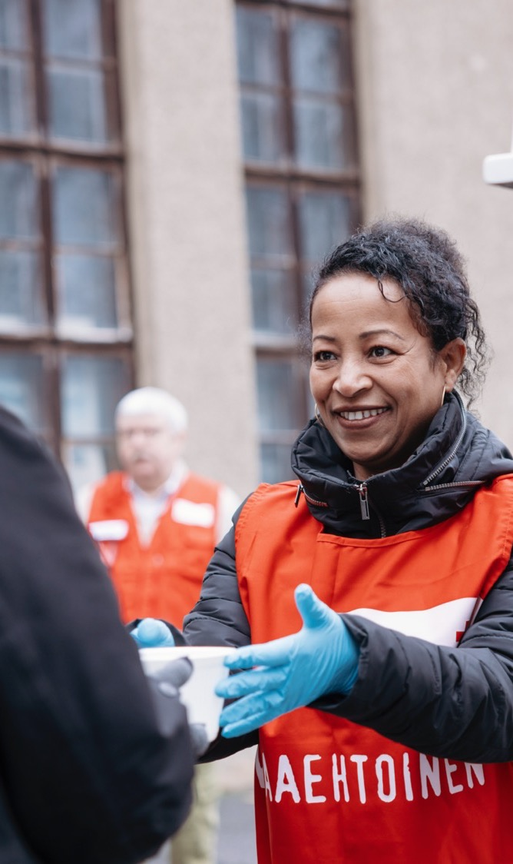
Thank you
Questions?
Picture: Joonas Brandt
Notes:
Picture: Joonas Brandt
EXERCISE: Mind map
The trainer asks the participants to write down things they have learned during the event. The trainer draws a mind map template on the flip chart, and writes ‘Red Cross’ in the middle in large letters. If there are many participants, the trainer may make two or three mind maps and divide the participants in small groups. The participants take turns writing on the flip chart and observe what the others have learned. They can also link what they learned to something another participant wrote.
Finally, the trainer chooses the suitable method for collecting feedback:
A) use the attached feedback form in connection with the mind map, or
B) as a thumb barometer by asking feedback from the participants.
The feedback form includes questions like
Was it worth participating?
Did you find your way of acting at the Red Cross?
Do you know how to continue as a volunteer?

